Slide 2
Climate change has been impacting the world and is a hot topic that arises every now and again. Whether it’s cyclical, caused by human emissions, or a combination of both, we know our world is getting hotter. It rains more in places where it normally does not rain and places that get a lot of rain are going through droughts. In our project we wanted to understand how climate has changed in Miami Dade county over the past 40 years. We compared data against other various counties around the nation to determine significant differences in temperatures, precipitation, and sunshine. We chose counties in arguably the coldest state in the contiguous United States, as well as some on the other side of the country. Our analysis concludes that Miami Dade County is one of the hottest counties in the country and has continued to get hotter. Our forecasts have determined that we are expecting the county to get half a degree hotter by July 2023.
Please note that these findings are for educational purposes only and for use at St. Thomas University. They are not peer-reviewed, certified, or approved by the necessary agencies as statistical evidence and should not serve as such.
Abstract

Slide 3
Analytics Purpose and Motivation
To understand how climate has change over the years, and how it might change over the next years.

Slide 4
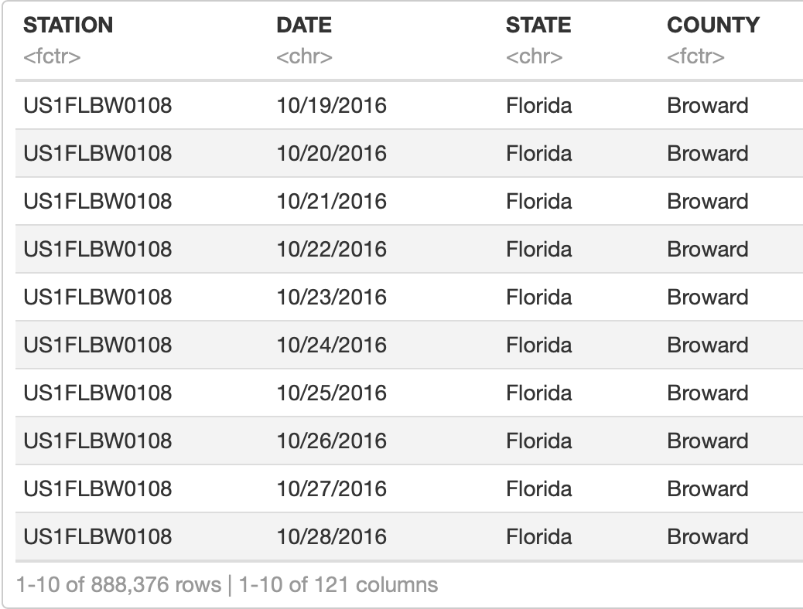

Data source and structure.
Data source is NOAA. They have a data extraction tool on their website going back to 1910 for Miami Dade County.
NOAA contains approximately 28GB of data for USA, and 3.5GB will be used for the project.
Data structure:
It was used 12.5% of the Data extracted from NOAA
9/27/2020
Add a footer

Slide 5


Data Preparation
9/27/2020
Add a footer

Slide 6
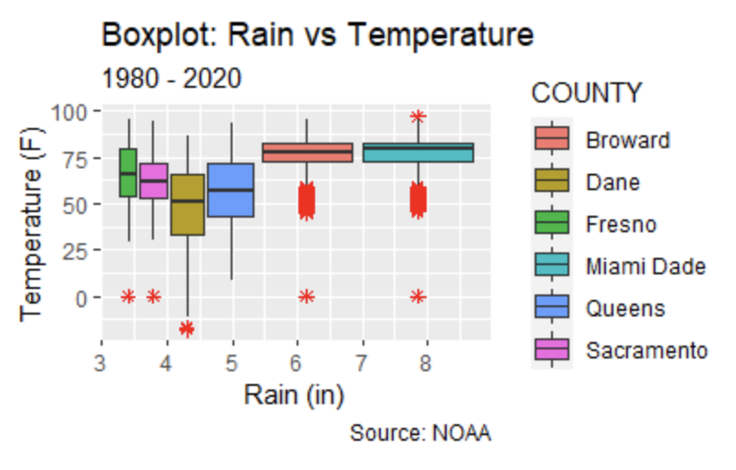
Exploratory Data Analysis
9/27/2020
Add a footer

Slide 7
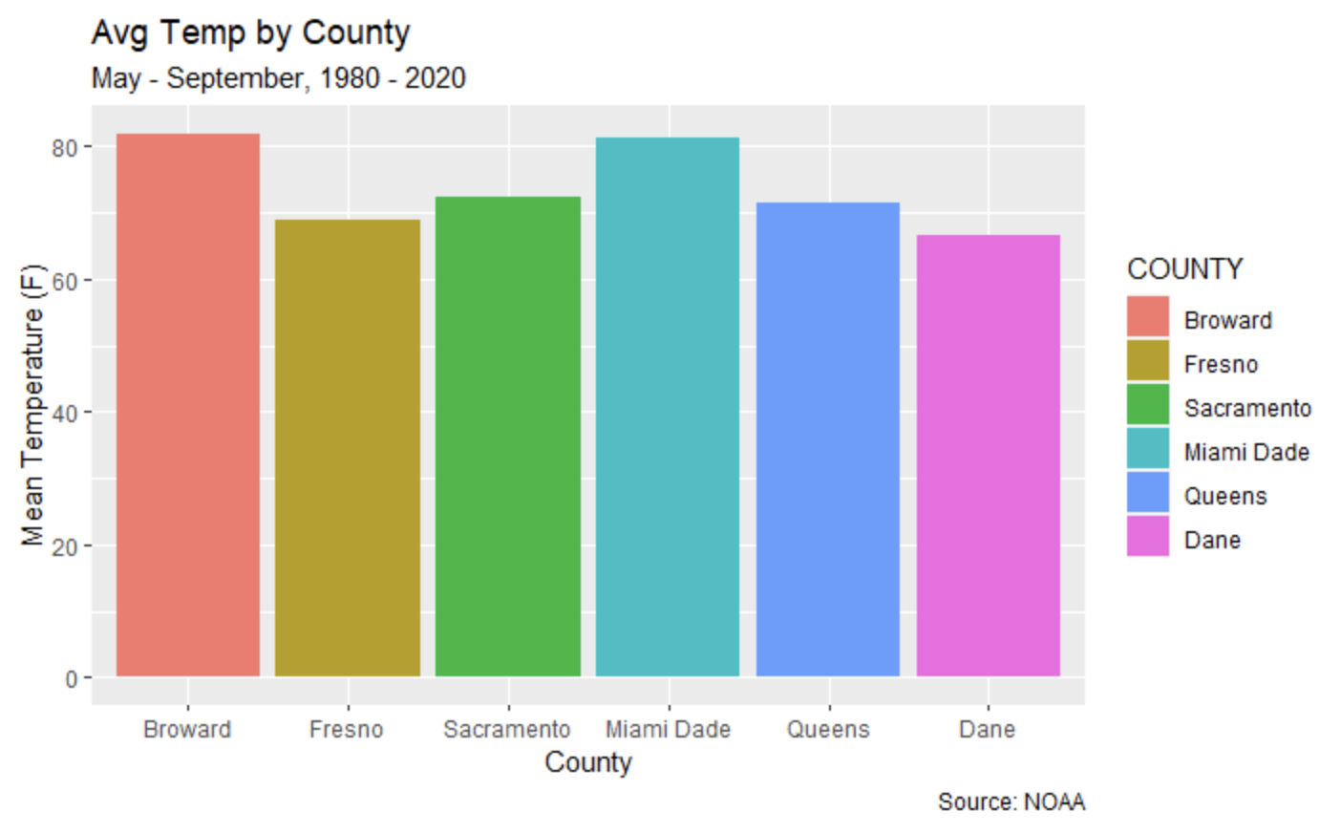
Temperatures during the Summer Months
Broward county has the highest average temperature with 81.9 degrees F. Miami Dade comes in a close second with 81.2 degrees F. Fresno has a standard deviation of 12 degrees, meaning their data points are very spread out.

Slide 8
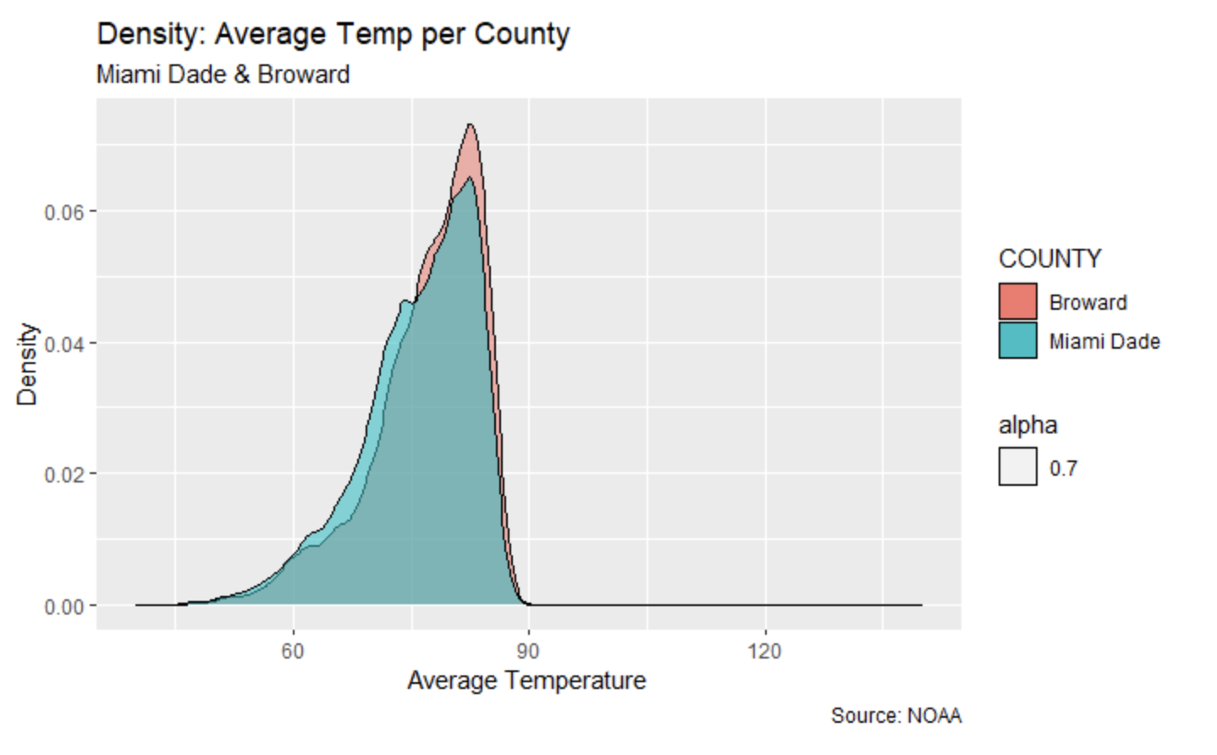
Temperatures during the Summer Months
Based on the density plot, and the sample sizes being over 134,000 points, we can assume data to be normal by the central limit theorem. Therefore, our test would be an unpaired t-test as they are both independent samples.

Slide 9
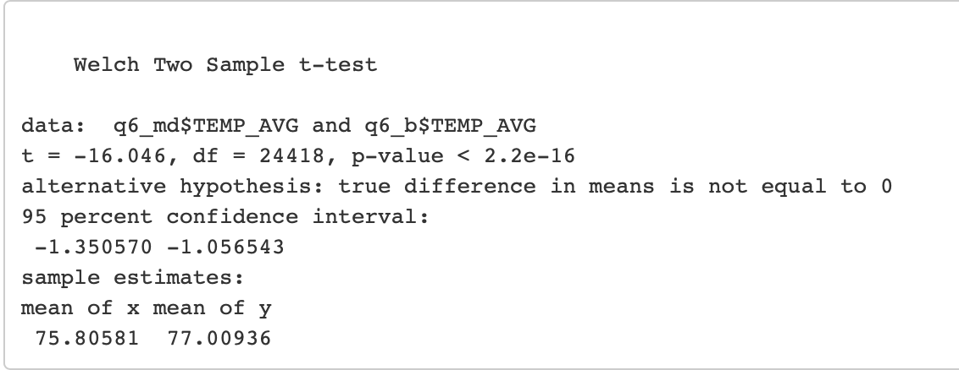
Temperatures during the Summer Months
T - Test
p-value of 2.2e-16 is less than our alpha of 0.05, thus reject null hypothesis. There is sufficient evidence to support the claim that the average temperatures between both counties is significant.

Slide 10
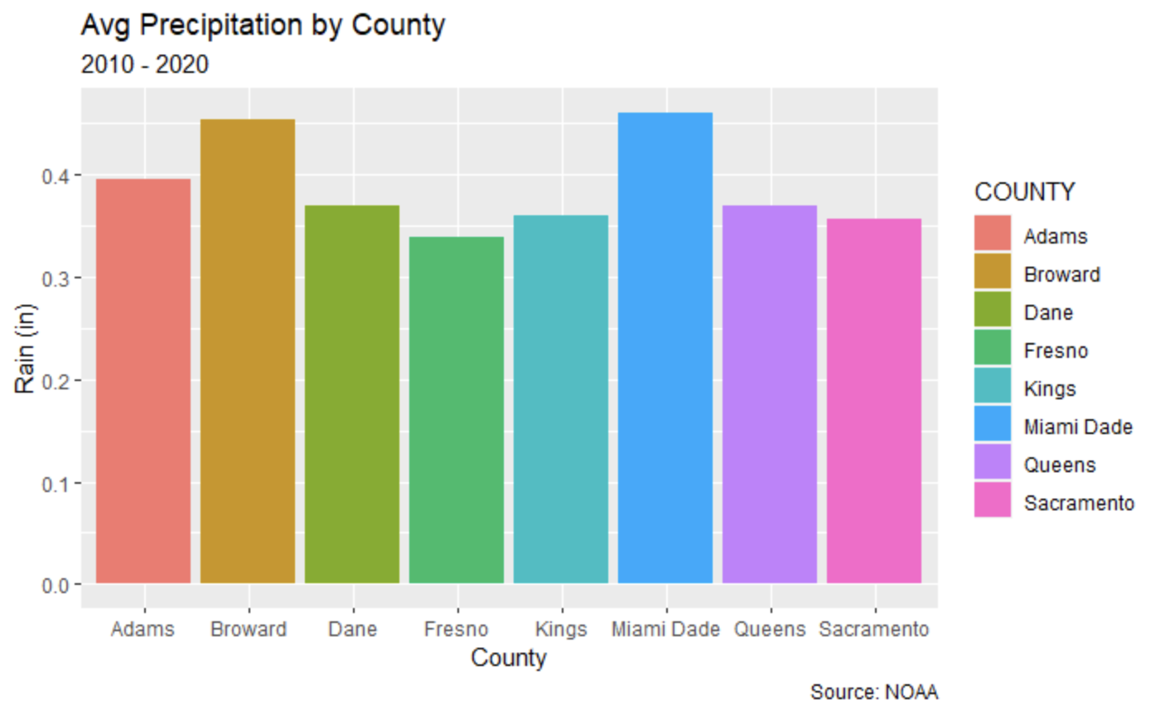
Rain Over the Past Decade
In a ten year span, it rained an average total of 0.46 inches per month in Miami Dade County and 0.45 inches per month in Broward. Fresno and Sacramento seem to have received the least amount of rain.

Slide 11
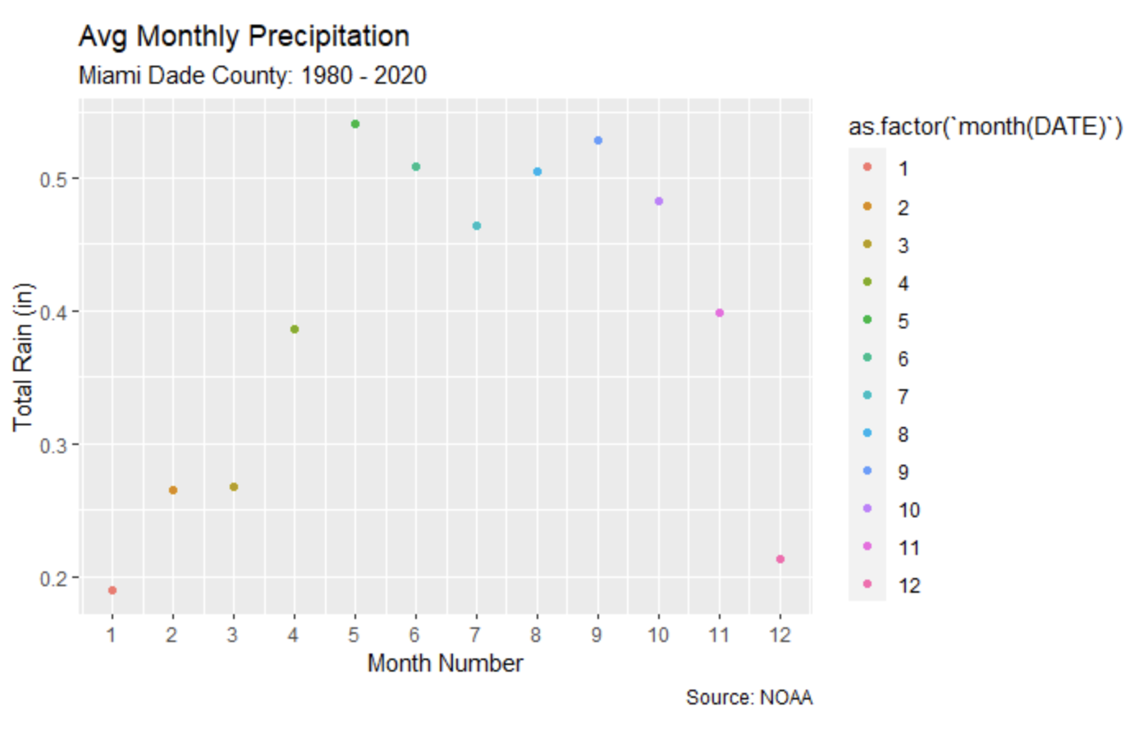
Rain vs Temperature
From this table, we can see that the month with the most rain is May. However, it rains almost twice as much during the summer as it does during any other time of the year.

Slide 12
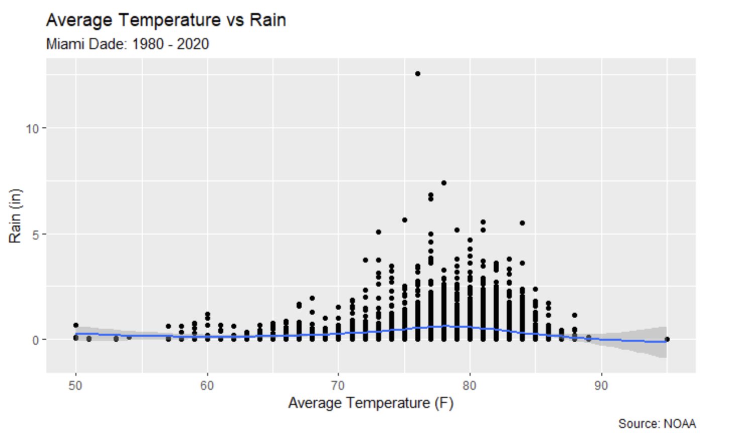
Loess Regression - Rain vs Temperature
There is no linear correlation between the two variables. Therefore, we will use a loess model. (cor: 0.03188158)
This loess trend line shows temperature vs rain and the best fit for a loess line.
Given a temperature of 90 degrees in Miami Dade, the expected rain amount in inches is: 0.5730619

Slide 13
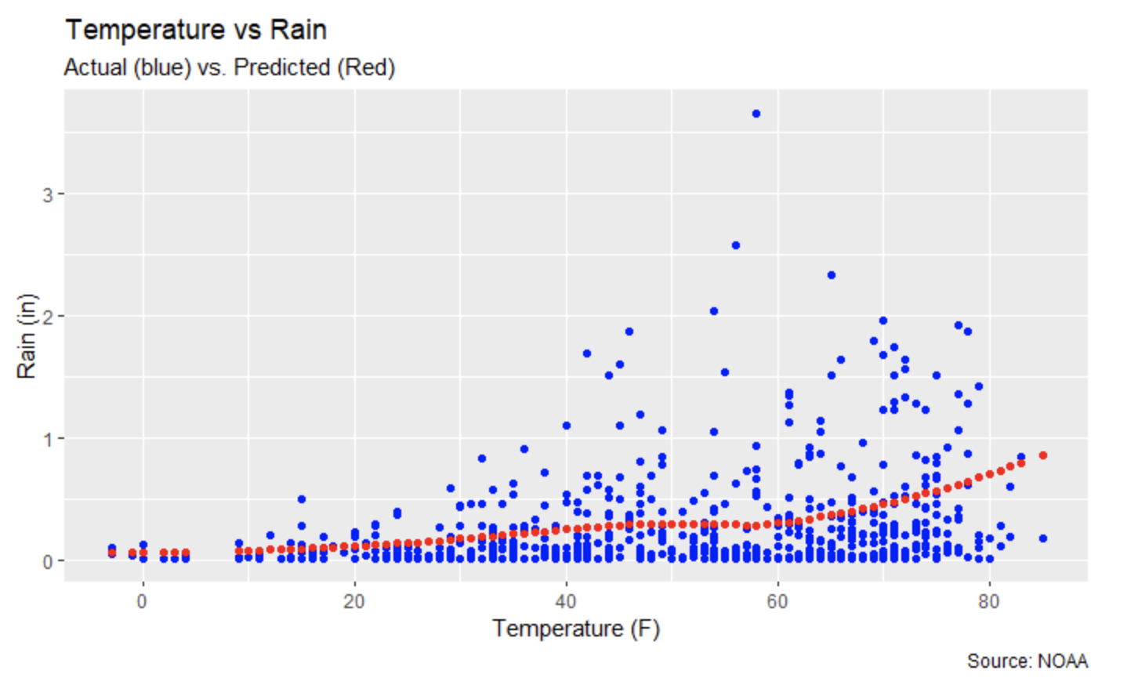
Rain Predictions in Wisconsin given Temperature
The highest the temperature, the more the model predicts rain to be.

Slide 14
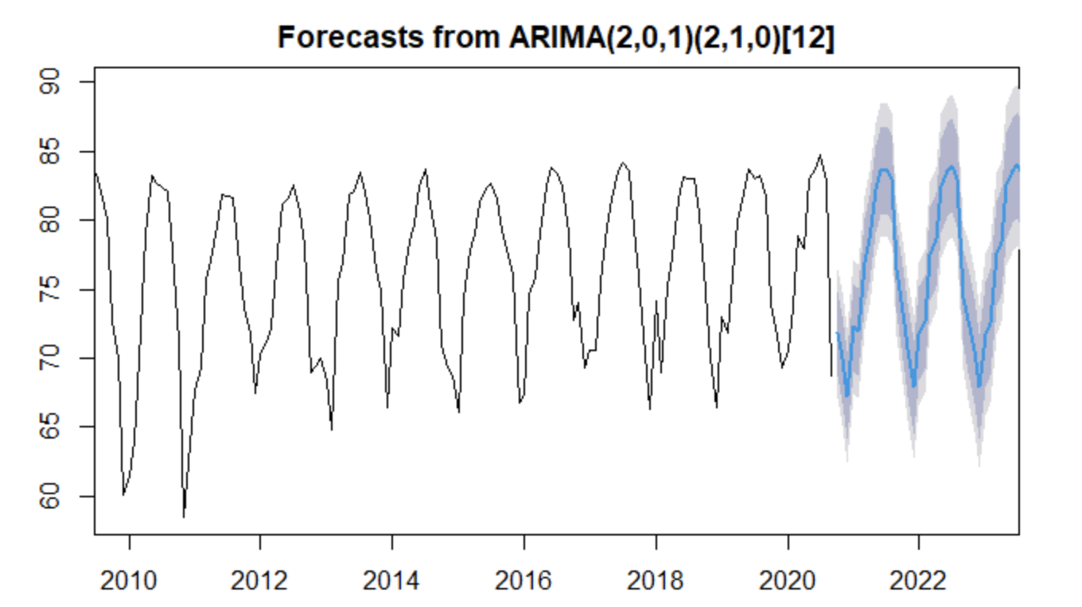
Time Series - July 2020 vs July 2023
The forecasted temperature in July 2023 is 84 degrees F, with a 95% confidence interval range of 78.1 to 89.9
Due to the volatility of the data, the error for our forecast are wide even with near term predictions.

Slide 15
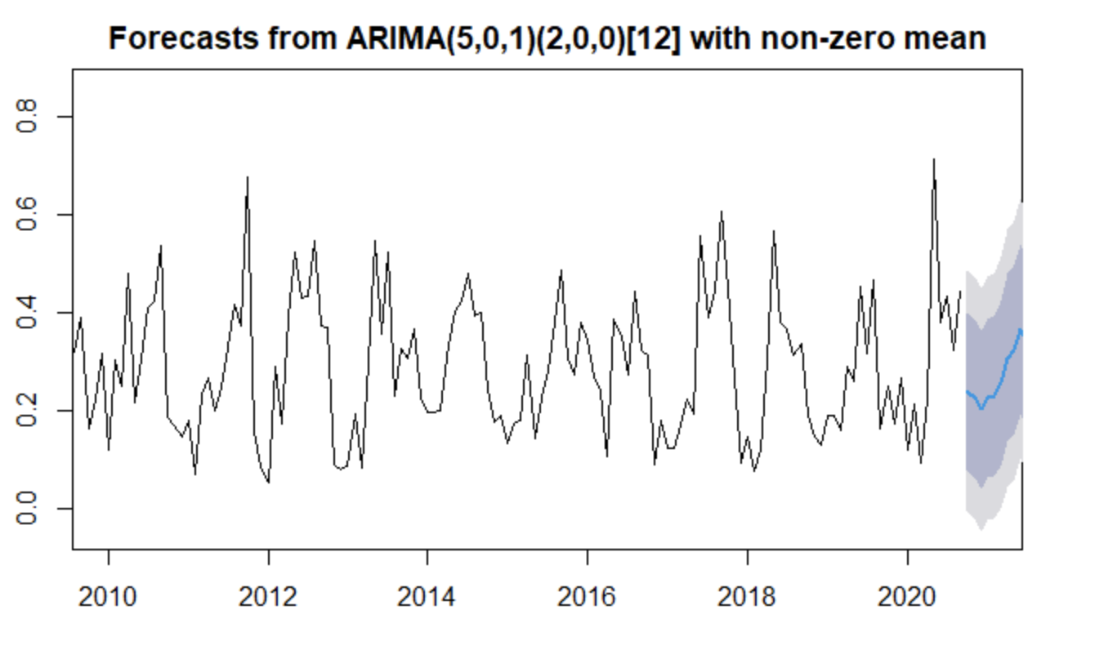
Time Series - Florida Rain Forecast
This data is also very volatile with more seasonal changes. The trend for this model seems to have been declining since 1990 and recently picking back up.
Over the next year, the average monthly rainfall is expected to be: 0.2796773 inches
The next year’s rainfall forecasts have a big error margin due to the randomness of the data.

Slide 16
Our analysis concludes that:
There is not a Linear Correlation between Rain and Temperature.
Miami Dade and Broward are the hottest counties from the ones we tested.
Miami Dade County is expected to become hotter by 0.30 degrees by July 2023
Temperature and Rain have high volatility, that’s why the ARIMA models show wide error bounds.
Analysis Conclusion

